Slide 1

Day One: What is Data Science?
Data Science Immersive
Notes:
Announcements:
Do your best to fill in the front of the class first to leave space in the back for staff - I know it’s a big class
Paired programming - there’s a talk on paired programming later this week
Phone booths
The amount of labs - you won’t finish all of them, nobody does. But the more you get done the better your understanding will be
That said, the best way to learn is by doing, so don’t let labs hinder your ability to work on projects

Slide 2
Outline
Introductions
What is Data Science?
What will we learn during the next 15 weeks?
Explore the data science process.
Notes:
Describe the data science process
Explain the classes of problems that data science can be used to solve
Define what makes a good data science question
List questions you can ask at the start of the process

Slide 3
Introductions
Name
What were you doing right before coming to Flatiron?
Guilty pleasure app on your phone
Notes:
Skills from different fields

Slide 4
What is Data Science?
According to wikipedia, the definition of data science is “an interdisciplinary field that uses scientific methods, processes, algorithms and systems to extract knowledge and insights from various forms, both structured and unstructured”
Notes:
Skills from different fields

Slide 5
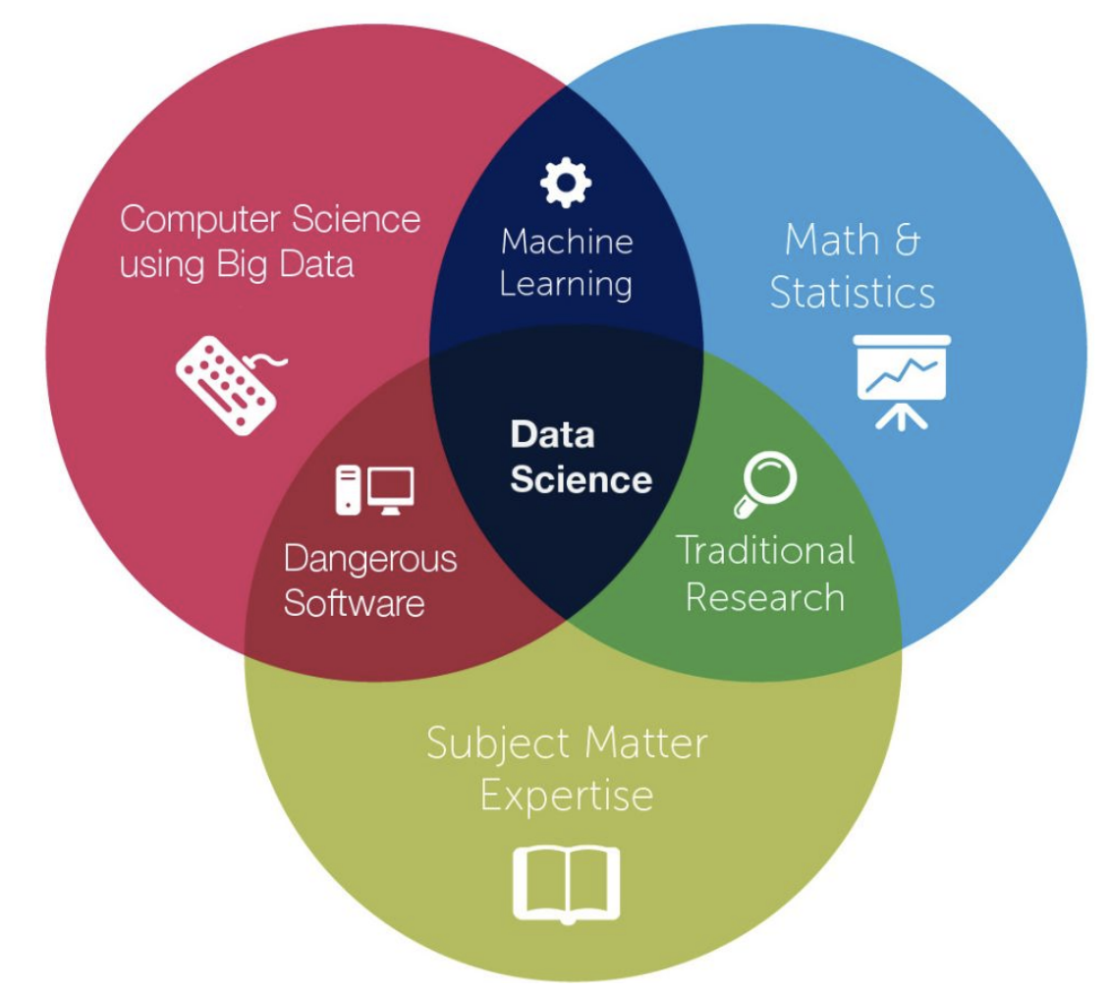
The Classic Data Science Venn Diagram

Slide 6
Defining Data Science
“Data science is a "concept to unify statistics, data analysis, machine learning and their related methods" in order to "understand and analyze actual phenomena" with data. It employs techniques and theories drawn from many fields within the context of mathematics, statistics, information science, and computer science.”

Slide 7
Mods 1: Python and Descriptive Statistics
Introductory Python
Object Oriented Programming
Descriptive Statistics
Data Cleaning/Visualization
Notes:
New course outline

Slide 8
Mod 2: Data Engineering
Web scraping, APIs, and JSON
SQL (and using SQL with Python)
Cloud Computing (AWS)
Notes:
New course outline

Slide 9
Mod 3: Inferential Statistics
Statistics
Probability
Hypothesis testing
Distributions
Statistical power
Notes:
Understanding integrals will help you immensely in this module

Slide 10
Mod 3: Statistical Inference
Linear Regression
Logistic Regression
Linear Algebra
Notes:
Understanding integrals will help you immensely in this module

Slide 11
Mod 5: More Machine Learning
SKlearn
Supervised Learning Models
Decision Trees
Ensemble Methods
KNN
SVM

Slide 12
Mod 6: Advanced Applications
NLP -Treating words as numbers
Recommendation Engines
Time Series
Clustering
Deep learning

Slide 13
Weeks 13-15:Final Project
One big long project - start to finish process
Data gathering
Research-motivated data processing and modeling
Presentable conclusions and/or model implementation
Work independently
A few optional advanced lectures

Slide 14
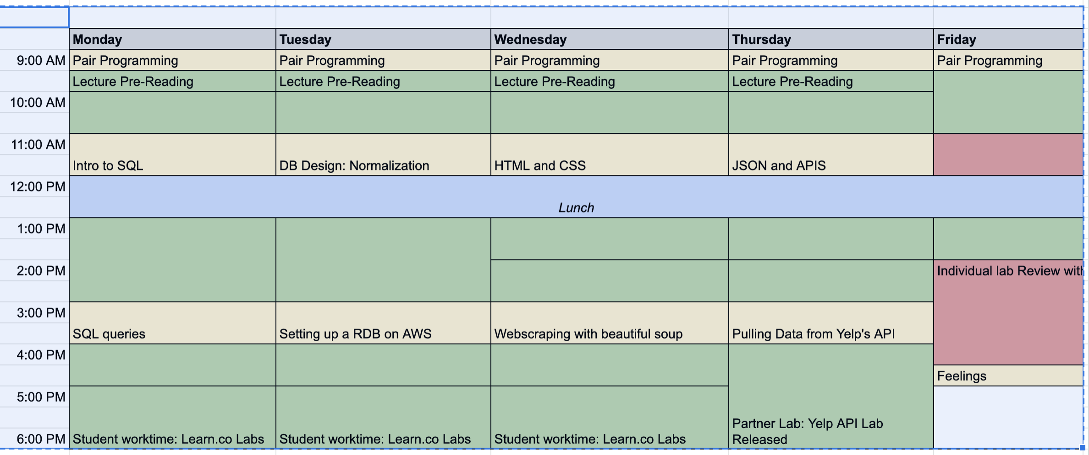
Weekly Schedule

Slide 15
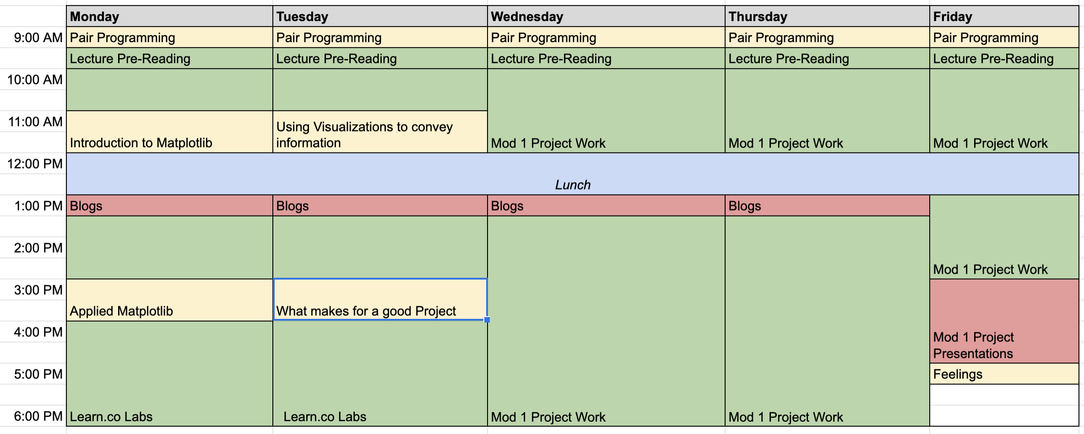
Project Week

Slide 16
Elements of the Course
Learn.co as textbook
Readme’s
Labs
Lectures & presentations from Instructor and Coaches
Pair Programming
Blogging
Projects & Science Fair
Feelings Fridays
Other community events 🍻

Slide 17
Tools We Use
Python 3.7 and Anaconda
Make sure you can run Jupyter Notebook
Pip and Homebrew
Excel - you’ll never want to use it for data analysis again
Slack - desktop app
Mobile app highly recommended (iOS & Android)
Class calendar
Github Account
Learn Environment (learn-env)
Make sure you’re in the class batch
Talk to Henry and Andrew

Slide 18
Non-Technical Challenges
Imposter Syndrome
Too Much Material
Jack of all trades, master of none
Burnout

Slide 19

Working through problems
Google/Stackoverflow
Phone a friend
Rubber Ducking

Slide 20
What kinds of questions can DS answer?
How many minutes, on average, is an American person exposed to advertisement?
Given the items you have purchased in the past, what items are you more likely to purchase in the future?
Does the $5 coupon or 25% off result in more returning customers for your favorite store?
Is a given image a llama or duck?
How should the government allocate educational resources?

Slide 21
Activity
Talk to your neighbor and identify a topic that you would like to investigate for one of your projects during this bootcamp.
Then brainstorm a question you would like to answer about that topic and lay out your plans or thought process to solve that problem.
Use a whiteboard to draw a picture represents that process. Think about the following in your graphic.
what goes in
what comes out
what happens in the middle

Slide 22
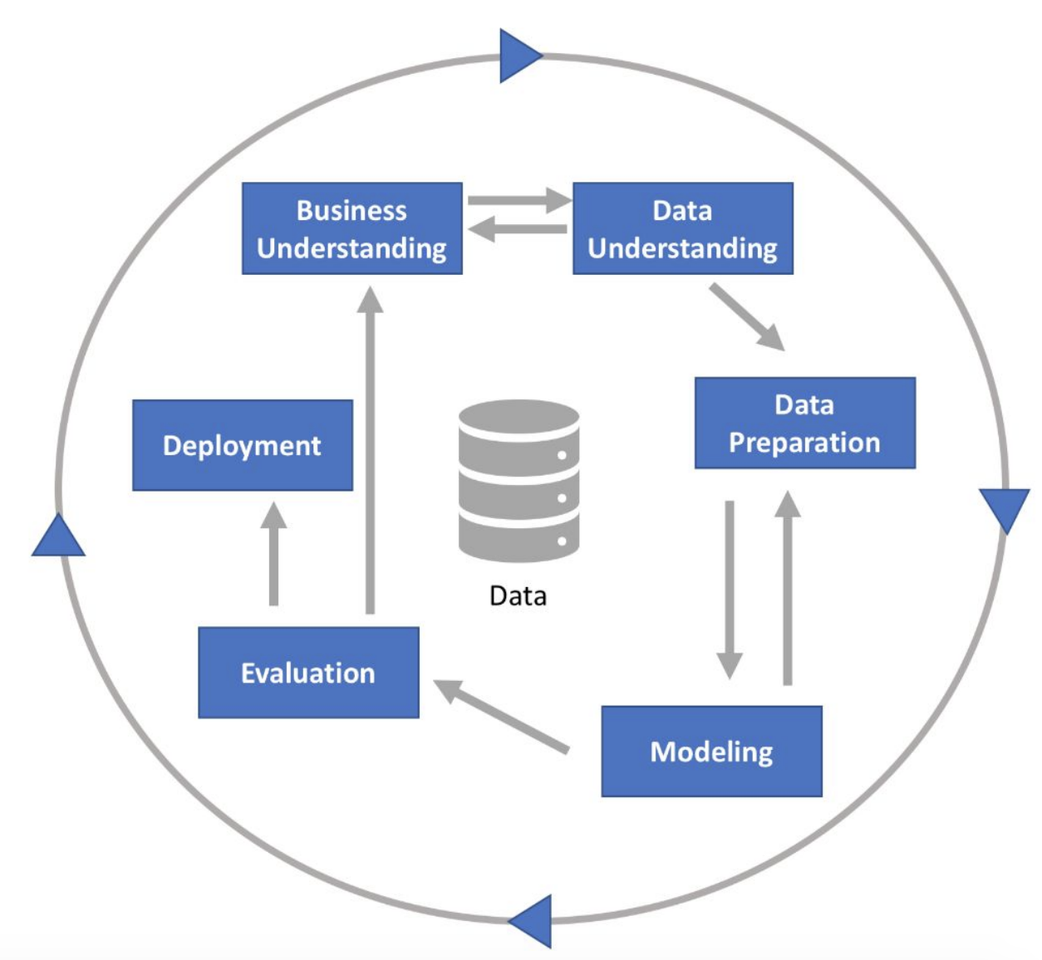
Data Science Process
Depends on what question you’re trying to answer
Notes:
Forming the question is a big part of it too
Scientific process motivated by empiricism

Slide 23
Next Steps
Make sure you have all the stuff from the previous slide running OK
Labs and readings through Learn.co
Pair Programming at 2
Github Lecture at 4

Slide 24
Next Steps
Interesting Data Science links:
Battle of the Data Science Venn Diagrams
10 Data Analytics Success Stories: A Closer Look
Supervised vs. Unsupervised Learning
Beyond Interactive: Notebook Innovation at Netflix
The 25 Best Data Visualizations of 2018

Slide 25

The End

